Slide 1
ABOUT US
Eight Centuries of Academic Excellence

Slide 2
ABOUT US
RESEARCH-INTENSIVE
MULTIDISCIPLINARY AND INTERDISCIPLINARY
BEST UNIVERSITY IN ITALY FOR TEACHING AND RESEARCH QUALITY
ITALIAN WORLD-CLASS UNIVERSITY
TOP 250 UNIVERSITY IN THE WORLD

Slide 3
RANKINGS
ARWU - Shanghai 2021: ranking 151-200
US News and World Report 2020: ranking 116
QS Ranking 2022: ranking 242
Times Higher Education 2022: ranking 201-250
University Impact Rankings 2021: ranking 99

Slide 4
WELCOME TO PADUA, ITALY

Slide 5
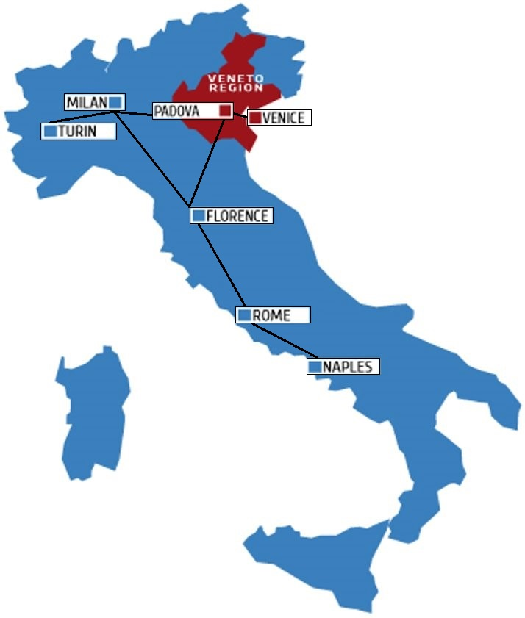
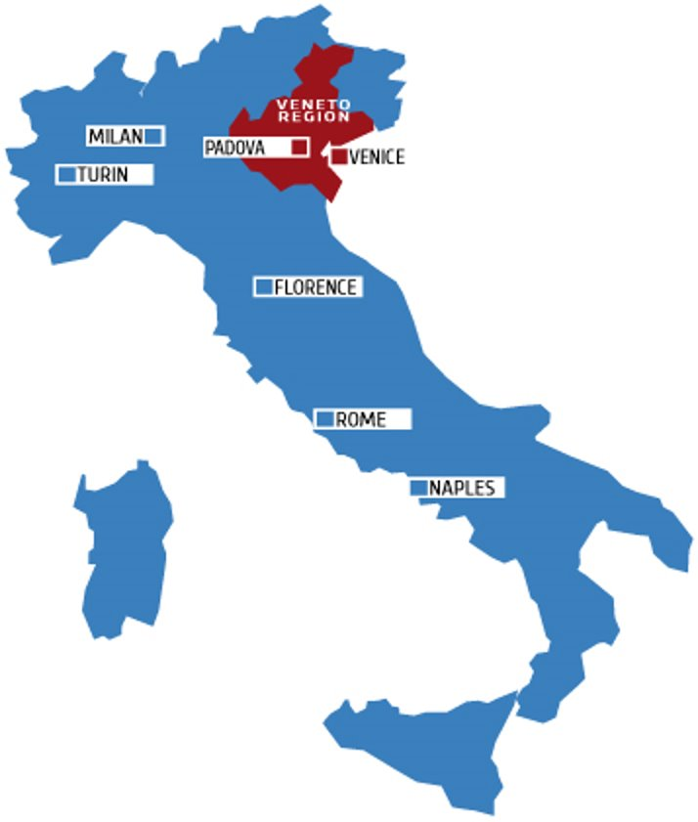
WELCOME TO PADUA, ITALY
ITALY
Population
over 60 mln
8° biggest world economy
55 UNESCO World Heritage sites
PADUA
Student-centred town
Unique setting
Strategic position
Wealthy region

Slide 6
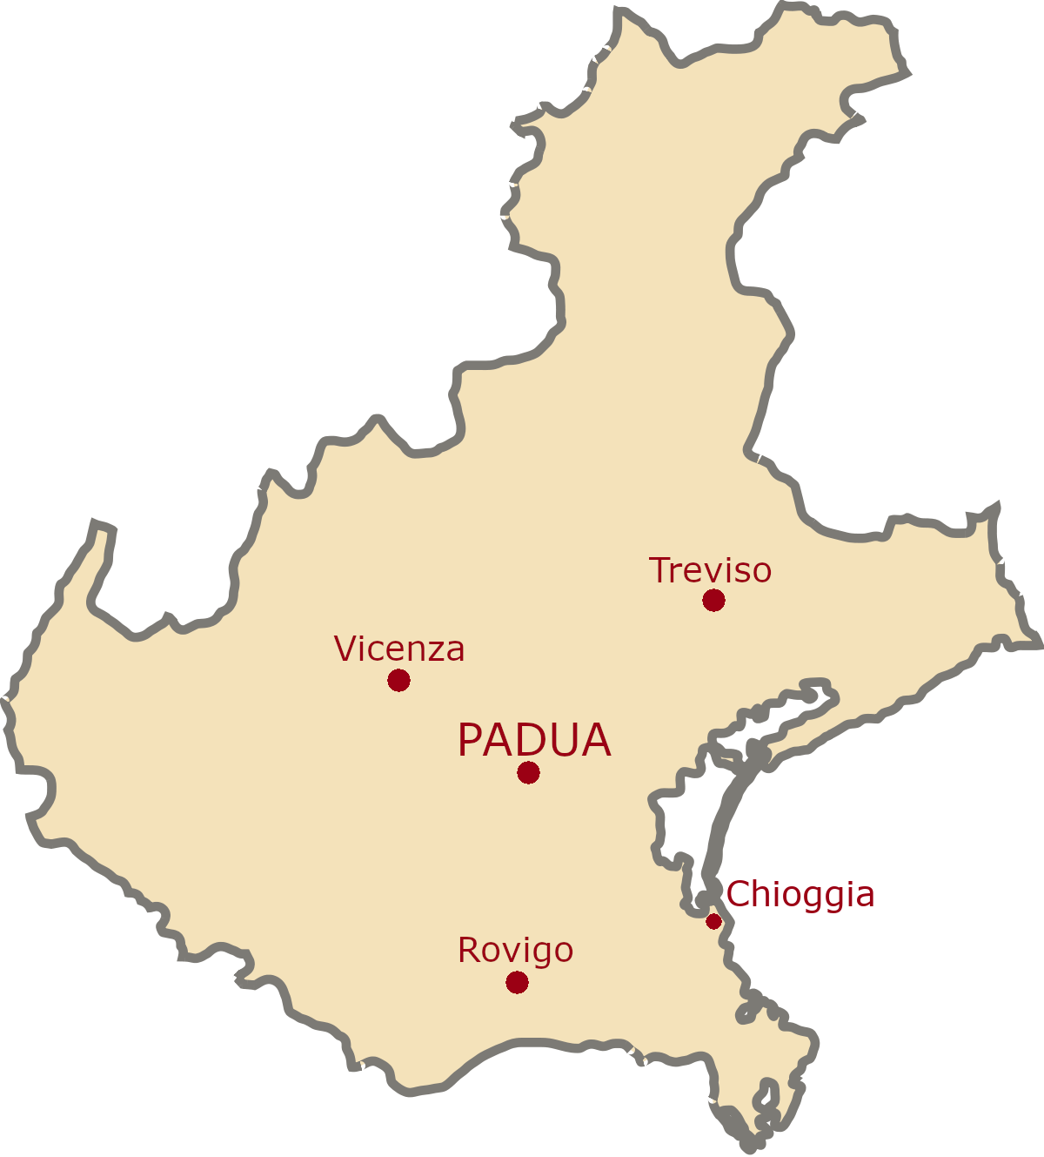
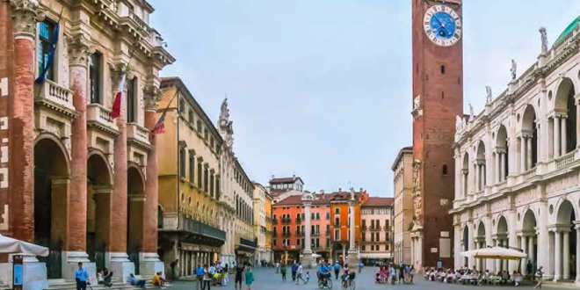
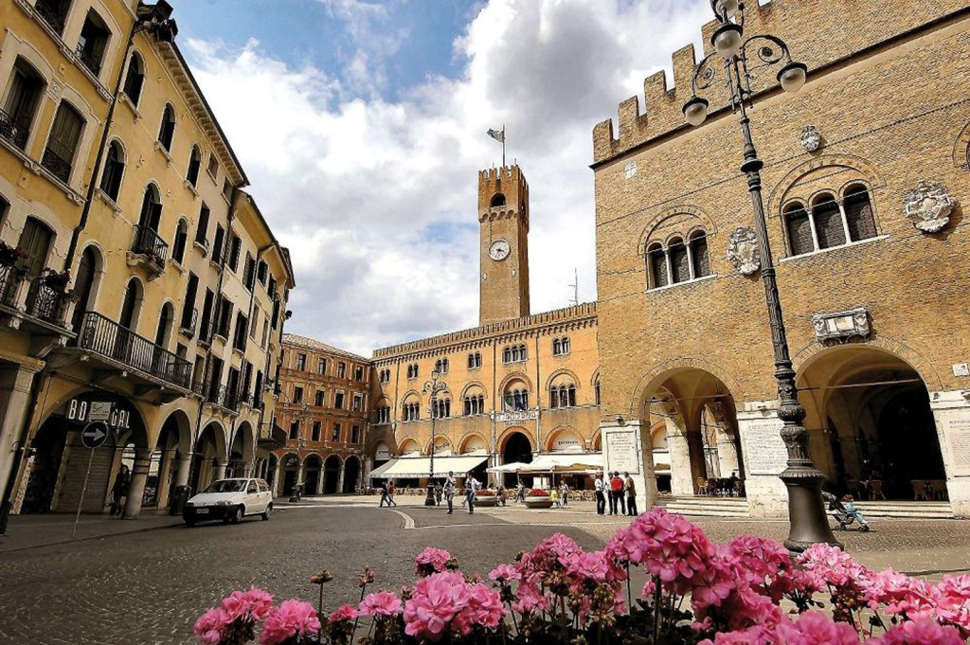
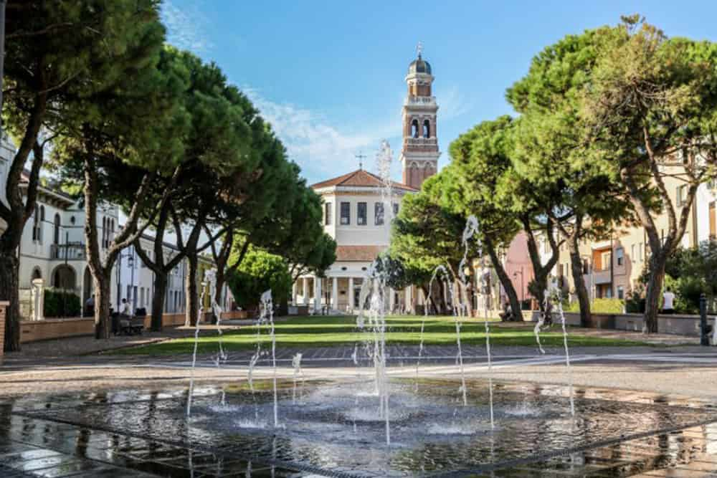
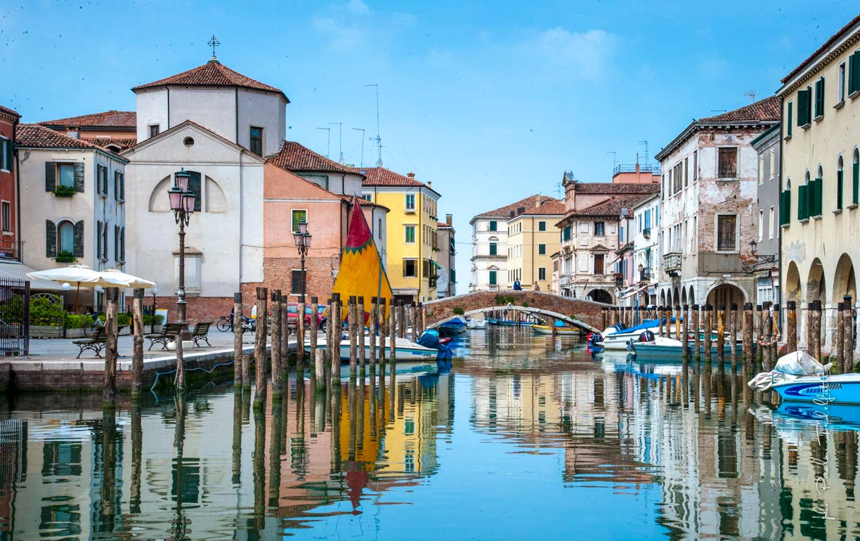
UNIPD CAMPUSES
Notes:
Chioggia: Marine Biology
Vicenza: Management Engineering
Rovigo: Water and Geological Risk Engineering

Slide 7
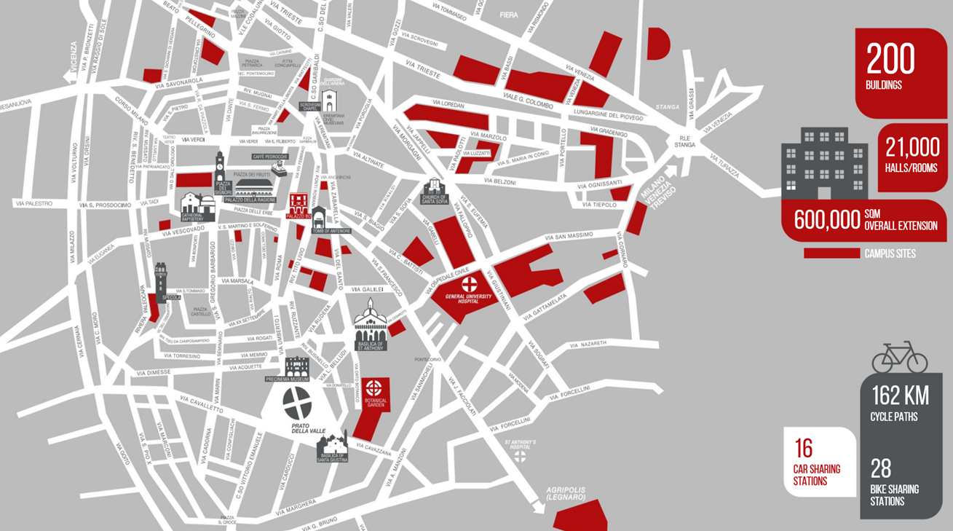
THE UNIVER-CITY
Notes:
Where is our «main Campus»? You actually are exactly in the centre of our Campus, which is spread all over the town. The town and the University are deeply embedded into each other, and have developed this way for the last …. almost 800 years
You are in the Ox (Bo) Palace, see the red ring in this map (building code is 0020).
The other buildings represent building the University either owns (blu and orange) or rents (pink and green) to organise its activities, from lecture halls, to libraries, offices, research and didactic laboratories, hospital premises, etc.

Slide 8
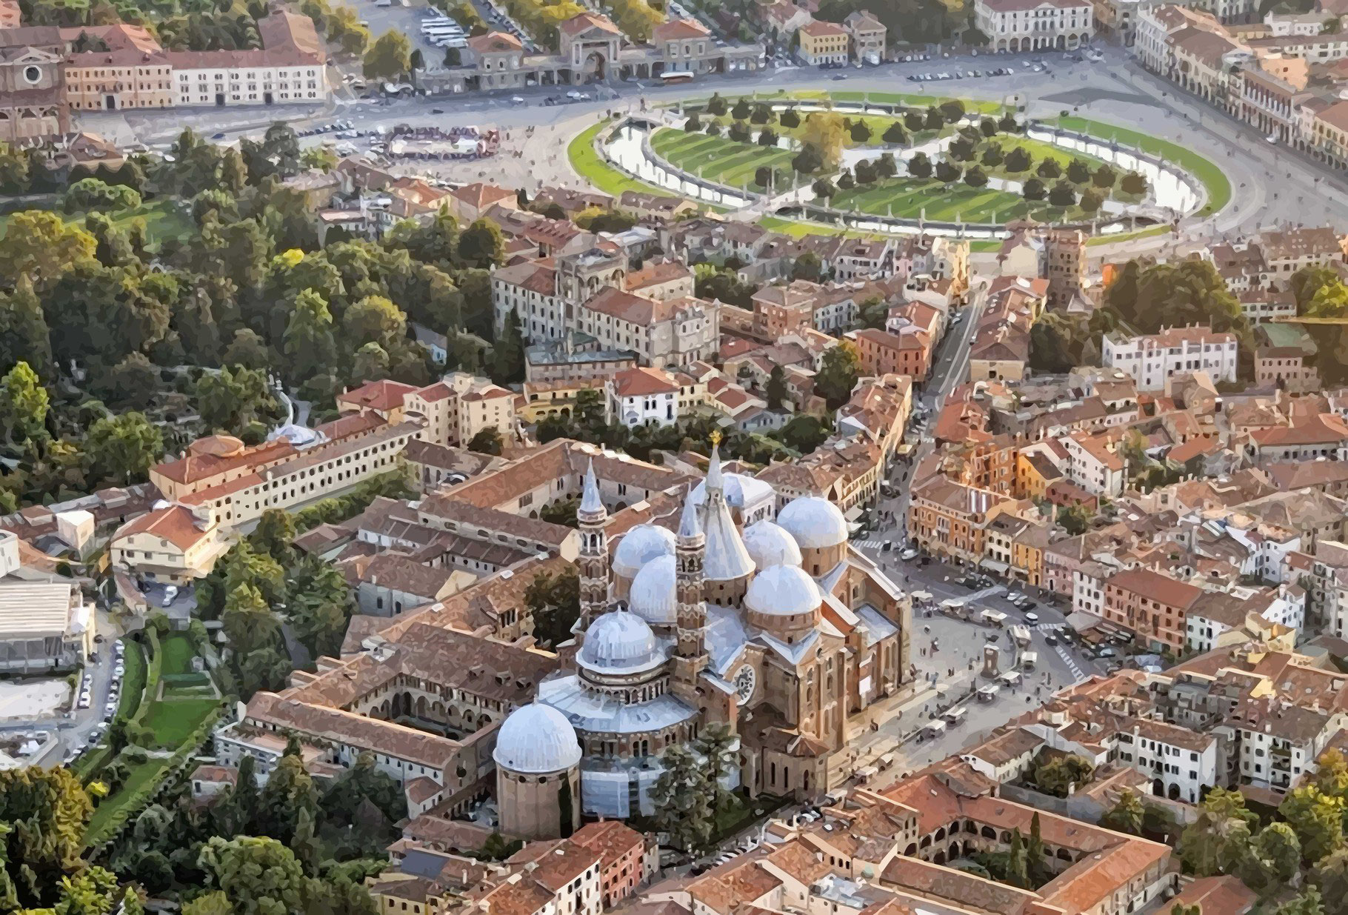
THE UNIVER-CITY
PADUA
AERIAL VIEW
Saint Anthony Cathedral

Slide 9
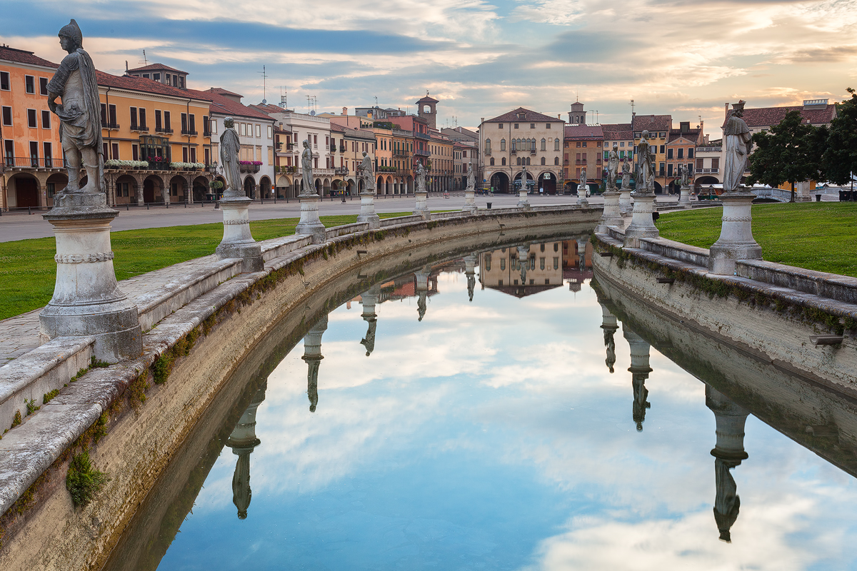
THE UNIVER-CITY
PRATO DELLA VALLE
Prato della Valle Square

Slide 10
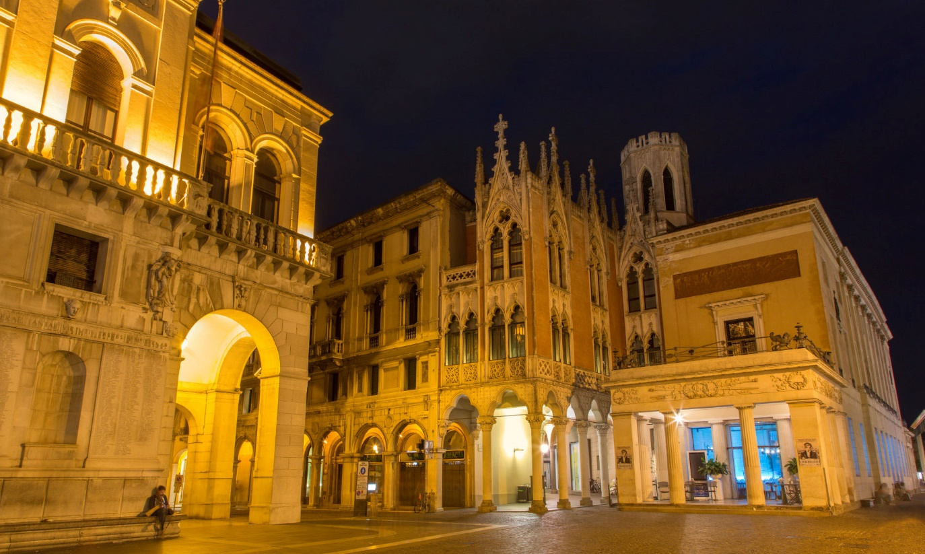
THE UNIVER-CITY
CAFFÈ PEDROCCHI
Caffè Pedrocchi

Slide 11
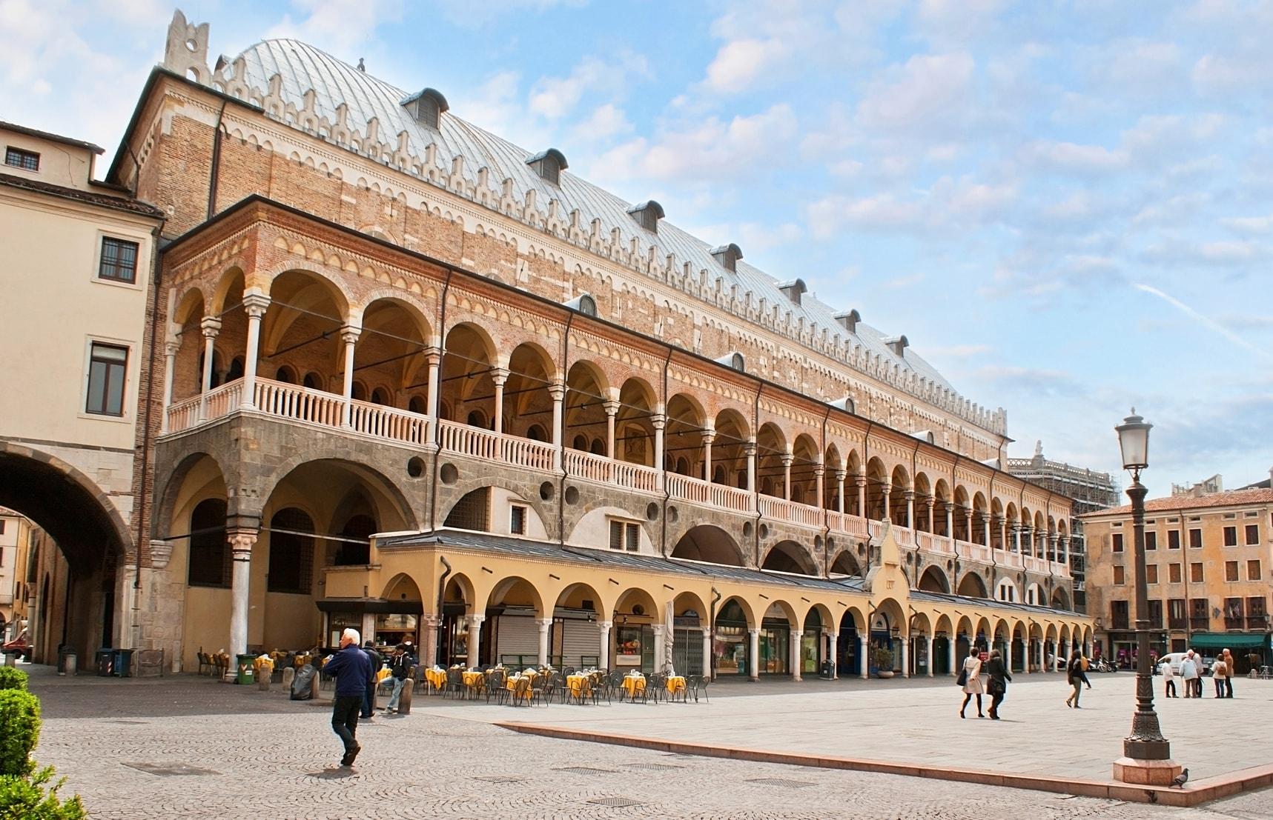
THE UNIVER-CITY
PALAZZO DELLA RAGIONE
Palazzo della Ragione

Slide 12
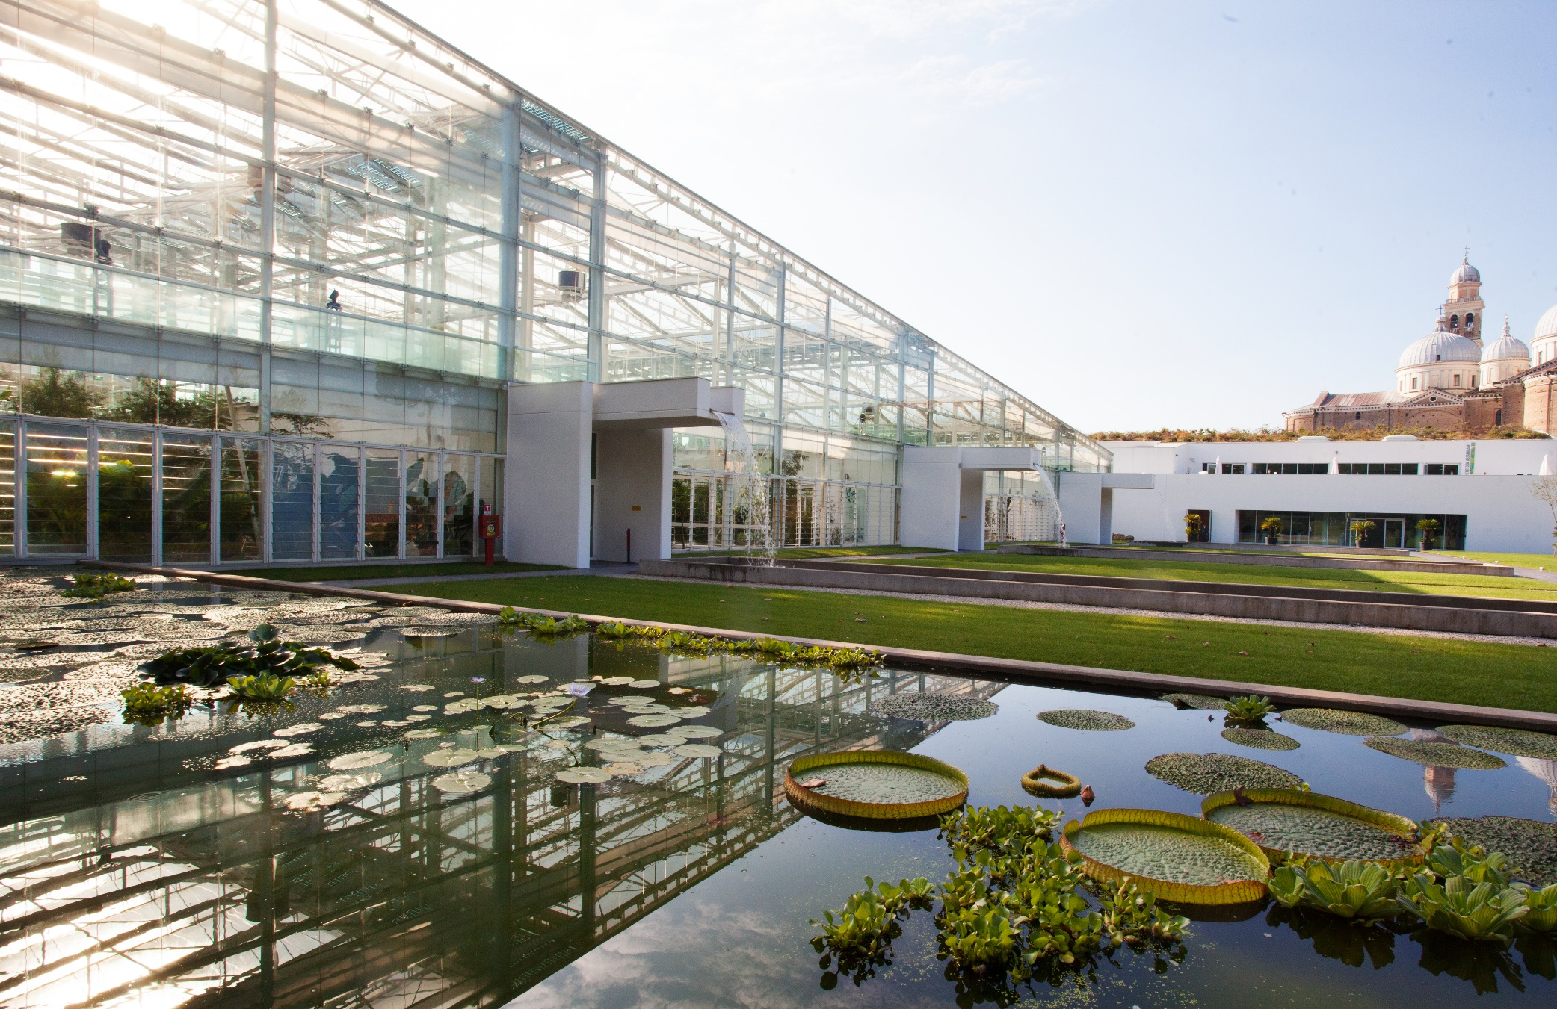
THE UNIVER-CITY
BOTANICAL GARDEN

Slide 13
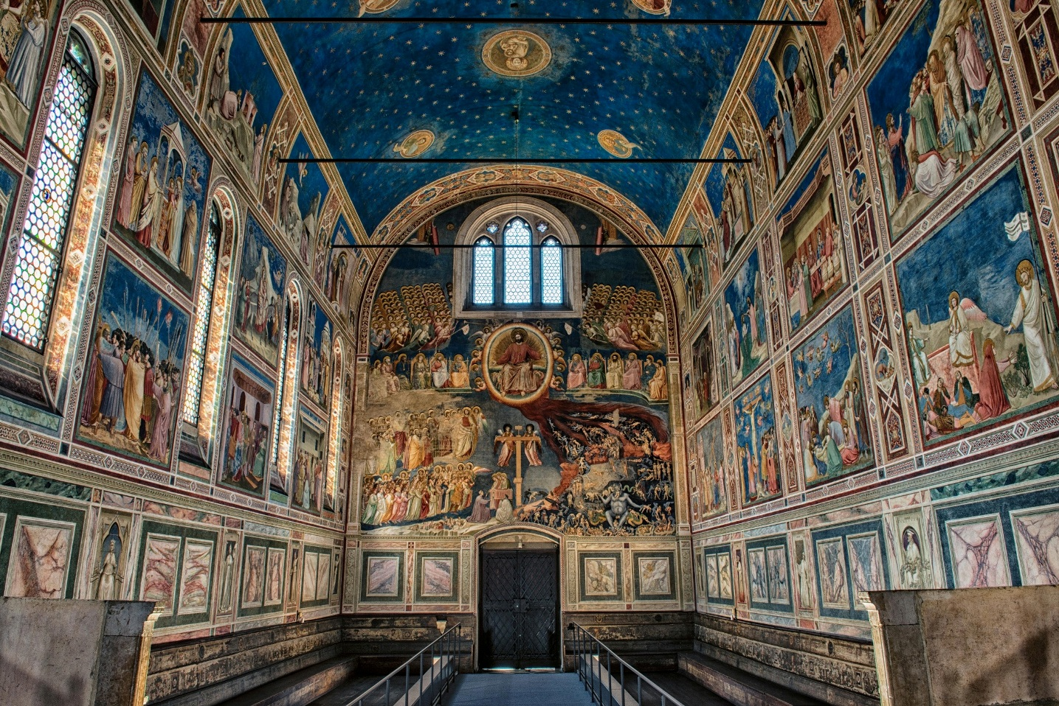
THE UNIVER-CITY
CAPPELLA DEGLI SCROVEGNI

Slide 14
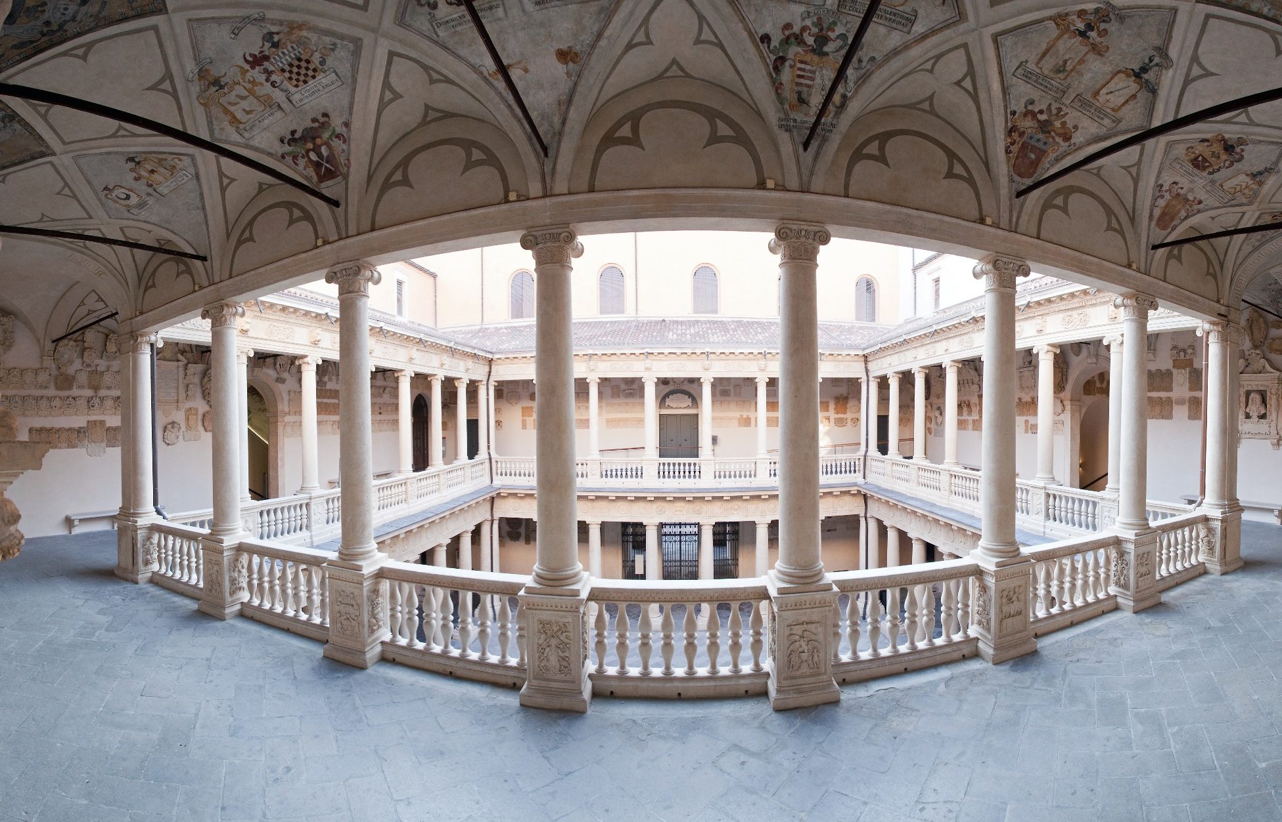
THE UNIVER-CITY
PALAZZO BO

Slide 15
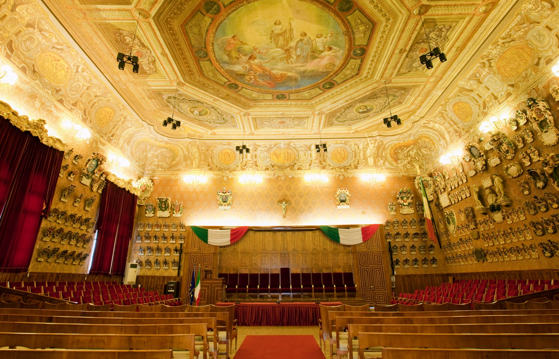
8 CENTURIES OF
ACADEMIC EXCELLENCE
HISTORY
TRADITION
INNOVATION
FOUNDED IN 1222

Slide 16
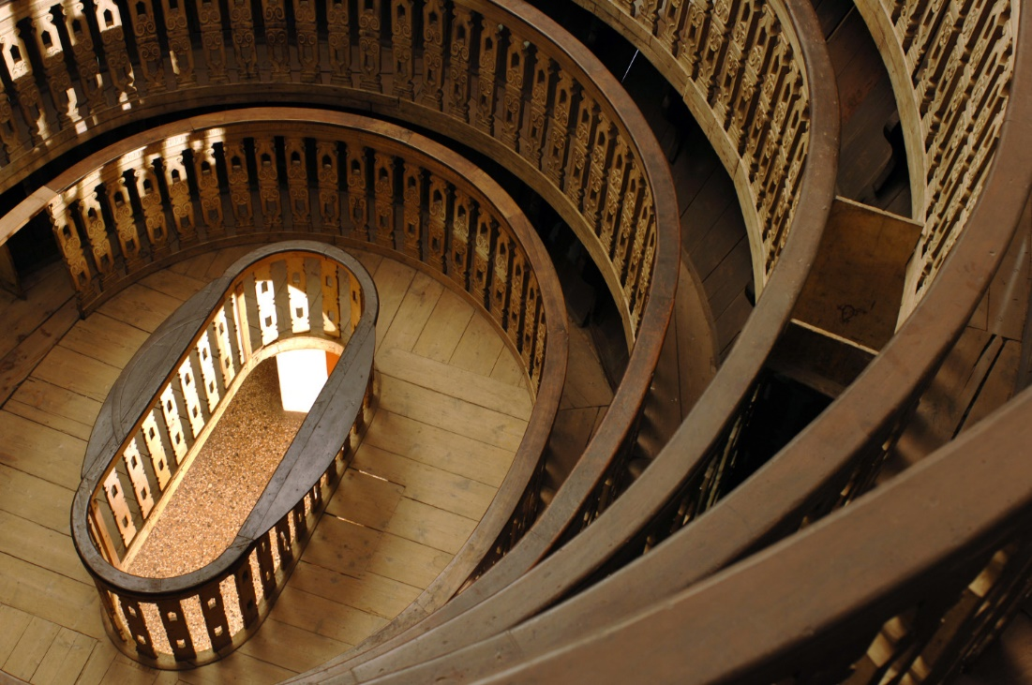
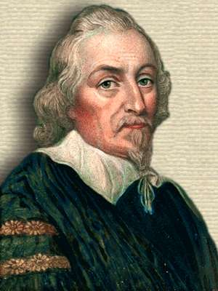
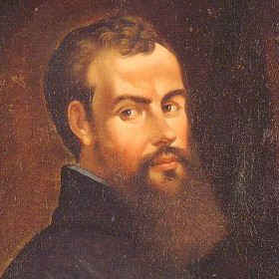
8 CENTURIES OF
ACADEMIC EXCELLENCE
THE BIRTHPLACE OF MODERN MEDICINE
William Harvey
(1578-1657)
Andreas Vesalius
(1514-1564)

Slide 17
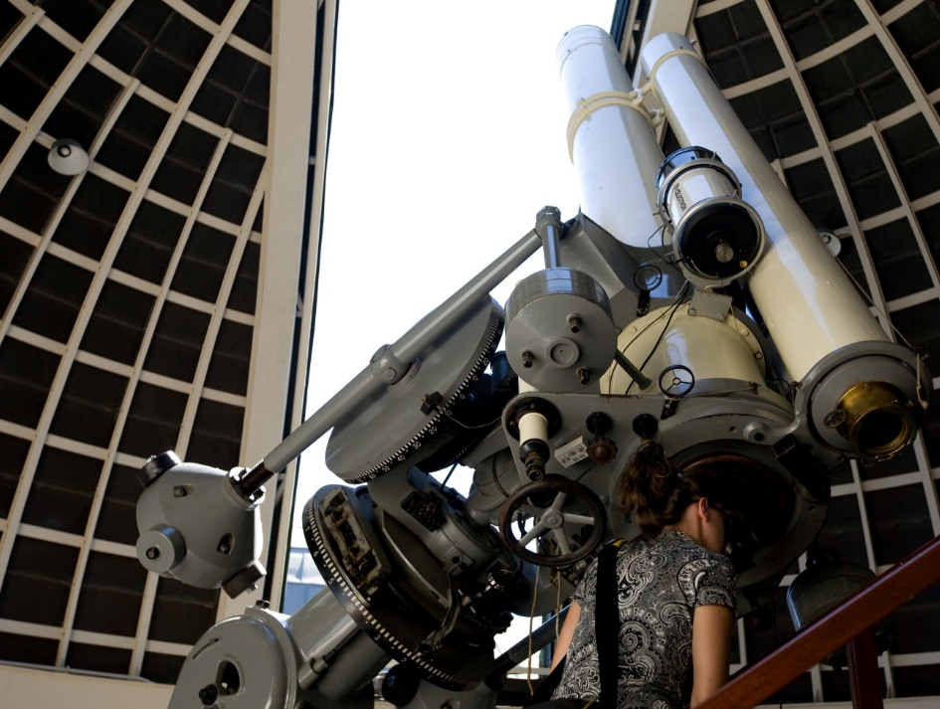
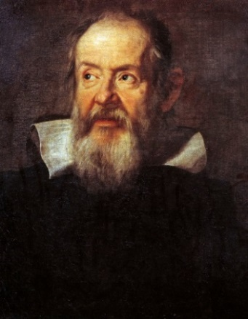
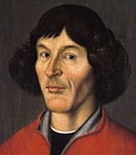
8 CENTURIES OF
ACADEMIC EXCELLENCE
THE SCIENTIFIC REVOLUTION
Galileo Galilei
(1564-1642)
Nicolaus Copernicus
(1473-1543)

Slide 18
8 CENTURIES OF
ACADEMIC EXCELLENCE
GENDER
EQUALITY
Elena Lucrezia
Cornaro Piscopia
(1646-1684)
1st woman to graduate
in 1678

Slide 19
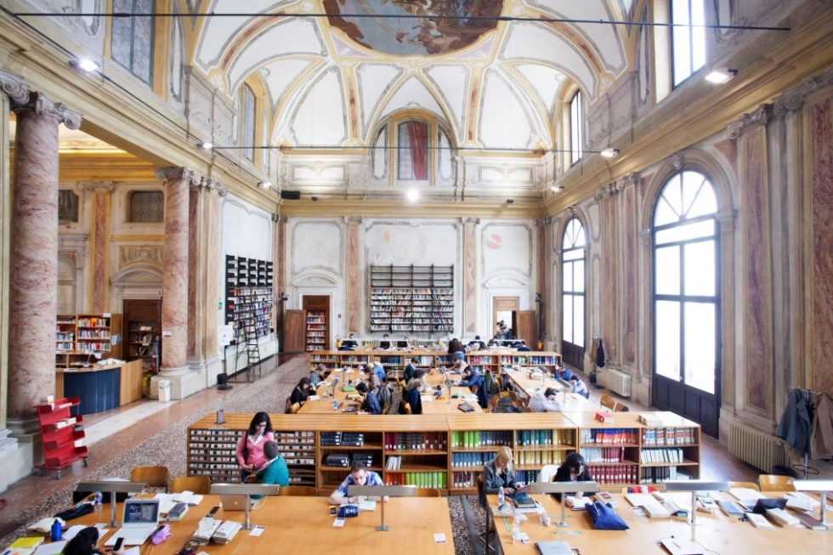
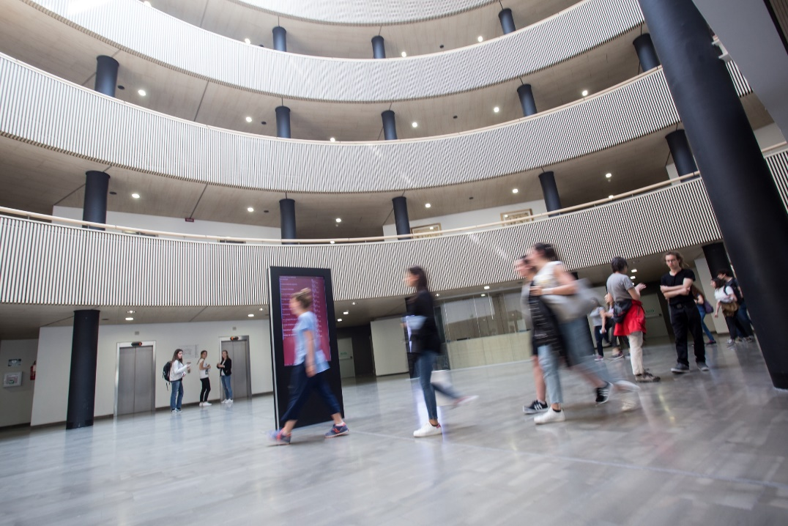
FACTS AND FIGURES
Over 60,000 Students Over 5,000 International students
Over 3,000 Academic Staff
Over 2,300 Technical & Admin Staff
32 Departments
8 Schools
1 University Hospital 1 Veterinary Hospital
29 University Libraries 13 University Museums
1 School of Higher Education
10 Halls of Residence
17 University Canteens

Slide 20
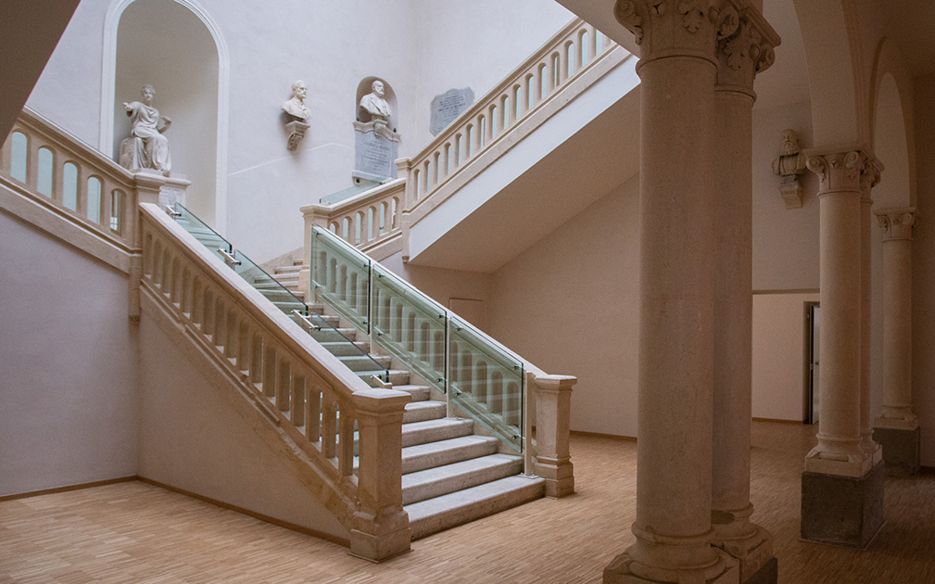
THE UNIVER-CITY
SCHOOL OF HUMANITIES

Slide 21
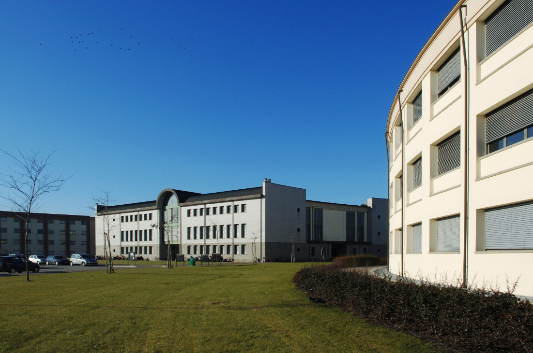
THE UNIVER-CITY
SCHOOL OF AGRICULTURAL AND VETERINARY SCIENCES

Slide 22
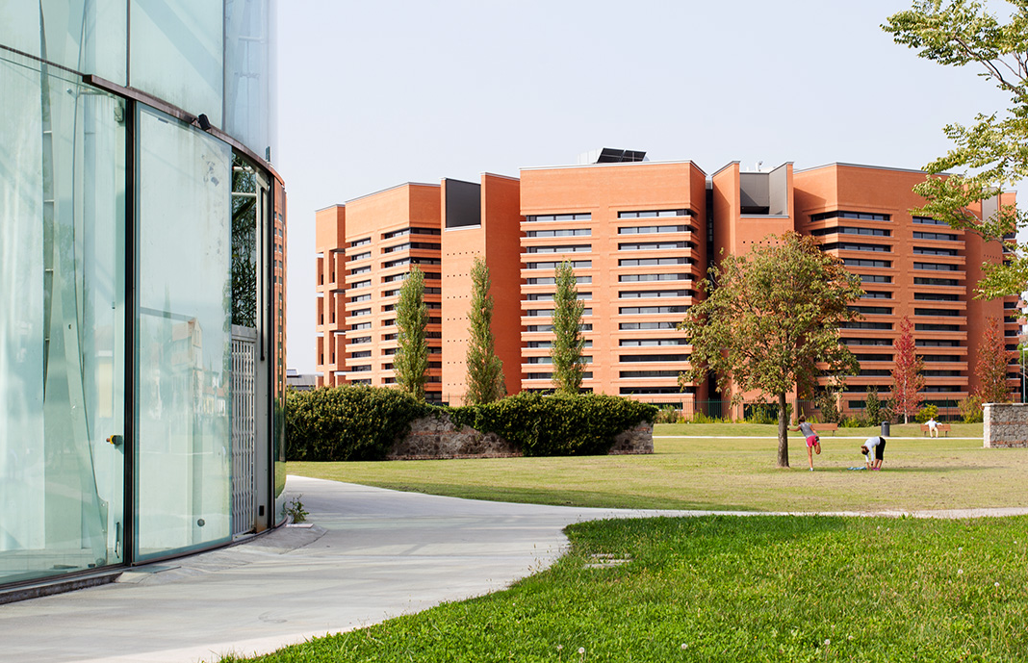
THE UNIVER-CITY
SCHOOL OF MEDICINE

Slide 23
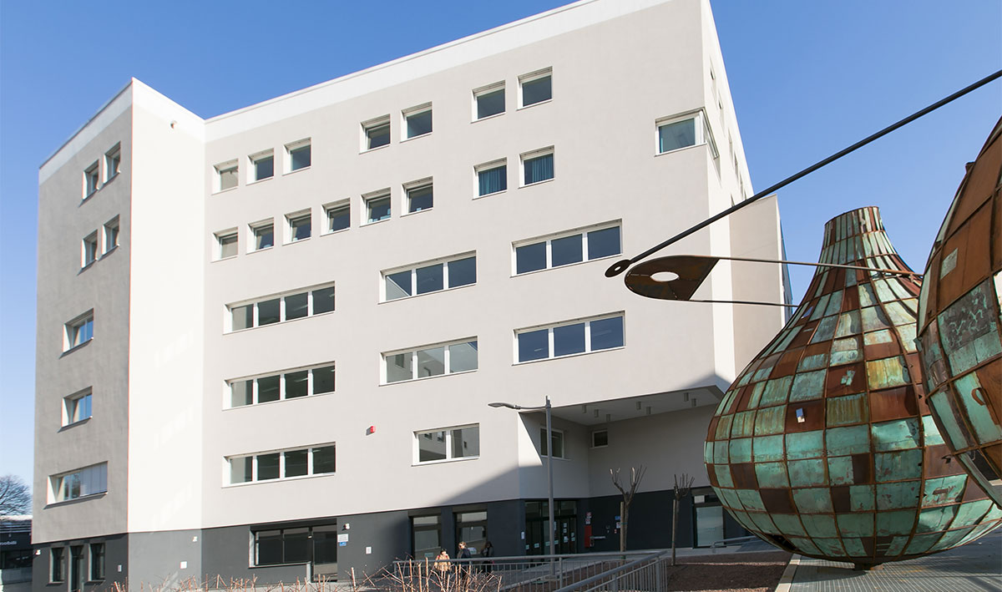
THE UNIVER-CITY
SCHOOL OF PSYCHOLOGY

Slide 24
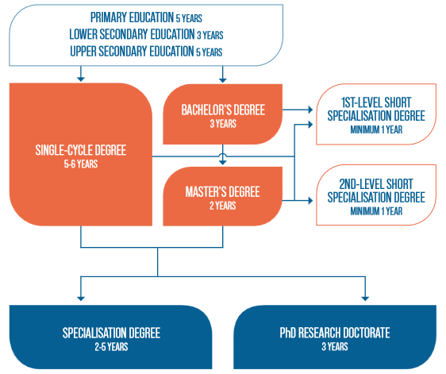
THE ITALIAN EDUCATION SYSTEM
Notes:
2019/2020

Slide 25
SUMMARY
ACADEMIC YEAR 2022/2023
 | 1ST SEMESTER | 2ND SEMESTER
CLASSES | OCTOBER 2022 – JANUARY 2023 | MARCH 2023 – JUNE 2023
EXAMS | JANUARY 2023– FEBRUARY 2023 | JUNE 2023– JULY 2023

Slide 26
A UNIQUE STUDENT EXPERIENCE
Student services and University facilities

Slide 27
HOUSING
Private market (flats and/or shared rooms).
Private colleges reserve a limited number of places exclusively for international students.
Housing Anywhere
The ESU Regional Agency provides accommodation for about 1,600 students in its 10 halls of residence, which are situated in the city centre or near the university buildings.
HOUSING OFFICE
housing@unipd.it
www.unipd.it/en/housing

Slide 28
STUDENT WELCOME SERVICES
BUDDY: (i.e. a senior University student) assigned to every newly arrived international student and will welcome and support him/her during the first weeks of their stay. Main activities include:
support during registration and enrolment procedures
showing university venues
(Departments, offices, canteens, libraries, study rooms etc.)
helping for accommodation
INTENSIVE ITALIAN LANGUAGE COURSE
free-of-charge
2-week long
registrations open during the summer (limited places)
SAOS (Servizio Accoglienza Ospiti Stranieri)
Provides assistance on immigration-related procedures
(visa, residence permit, health insurance, etc.).
www.unipd.it/en/saos

Slide 29
STUDENT SERVICES
INCLUSION OFFICE for students with disabilities or Specific Learning Disabilities (SLD)
PSYCHOLOGICAL ASSISTANCE SERVICE
TUTORING: support throughout the University career (time management, organisational difficulties, study plan etc.)
EXCHANGE OPPORTUNITIES
all over the world
CAREER SERVICE AND JOB PLACEMENT: internships and job opportunities for students and graduates.
www.unipd.it/en/student-administration-and-support
www.unipd.it/en/erasmus-and-other-exchange-programmes
Notes:
24.000 internships
1.500 job offers
4 Career Days
more than 20 company meetings with students
10 company tours
16 seminars and 350 individual interviews about career guidance

Slide 30
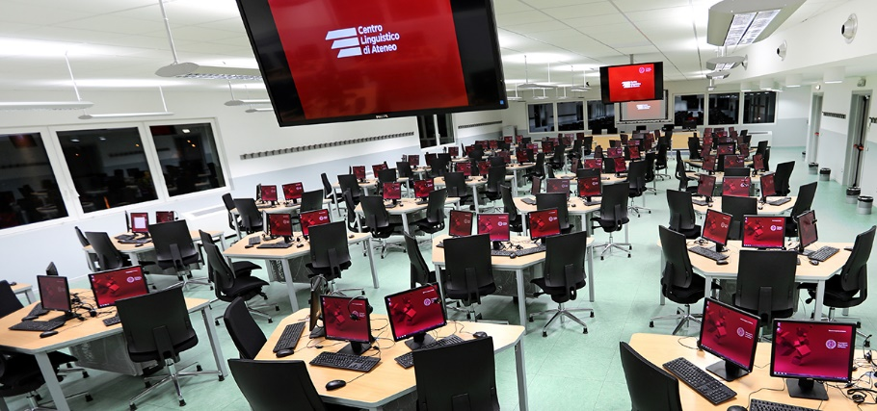
A UNIQUE STUDENT EXPERIENCE
University Language Centre (CLA)
Modern foreign languages (English, French, German, Spanish, Russian, Arabic) and Italian as a foreign language
Test centre for official language certifications: IELTS, CILS , TestDaF, TORFL
Media library
University Sport Centre (CUS)
Sport (athletics, rugby, volleyball, basketball, boat races…) both at competitive and amateur levels
Two sport facilities in Padova
Economic benefits for athlete-students with specific agonistic sport merits.

Slide 31
WATCH OUR VIDEO “10 reasons for studying in Padua”
www.youtube.com/watch?v=Zl6vKRe6PWc

